Slide 1
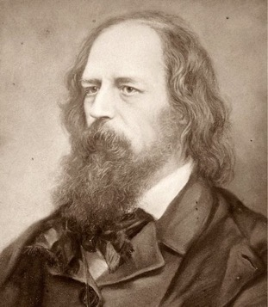
A lie that is half-truth is the darkest of all lies
Alfred Tennyson

Slide 2
Unless otherwise indicated, all information that follows comes from carefully vetted mainstream sources

Slide 3
1. How dangerous is COVID-19?

Slide 4
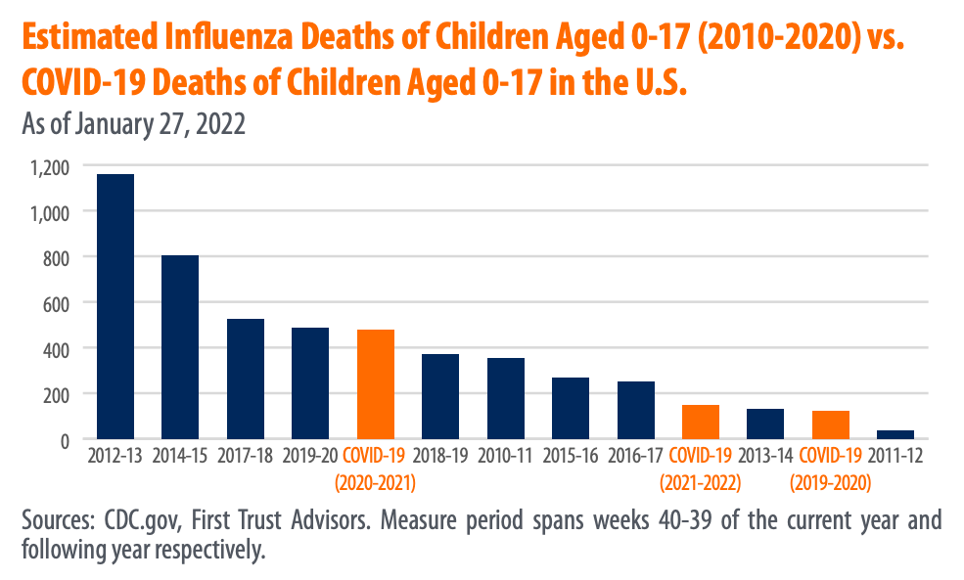
The flu season of 2012-2013 was far deadlier for people aged 0-17 years.
Downloaded from First Trust Advisors: https://www.ftportfolios.com/blogs/EconBlog/COVID-19

Slide 5
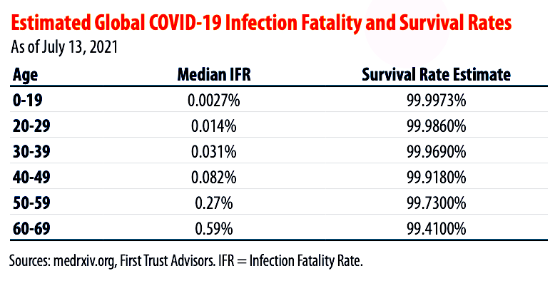
The infection fatality rate for young people infected with COVID is barely measurable.
Downloaded from First Trust Advisors: https://www.ftportfolios.com/blogs/EconBlog/COVID-19

Slide 6

The overall infection fatality rate for COVID-19 improved dramatically in weeks leading to 2022.
Downloaded from First Trust Advisors: https://www.ftportfolios.com/blogs/EconBlog/COVID-19

Slide 7
COVID-19 death rates in South Africa barely changed despite the spike in cases for the Omicron variant.
Less that 50% of the adult population is vaccinated.
Downloaded from First Trust Advisors: https://www.ftportfolios.com/blogs/EconBlog/COVID-19

Slide 8
2. How effective is natural immunity for mitigating transmission of COVID-19?

Slide 9
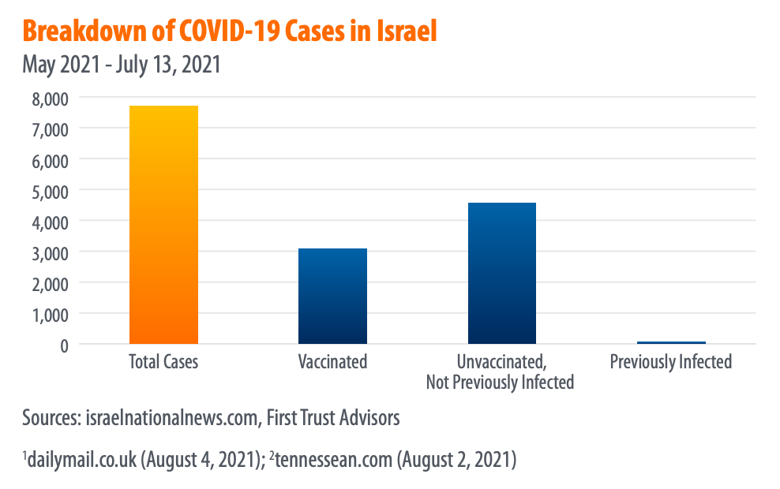
Natural immunity is far more effective than immunity by means of vaccination.
Downloaded from First Trust Advisors: https://www.ftportfolios.com/blogs/EconBlog/COVID-19

Slide 10
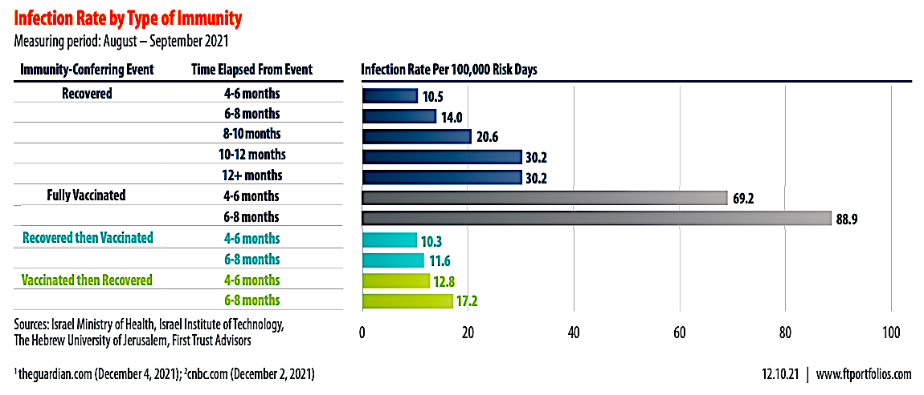
Vaccination fails to provide additional protection to people with natural immunity to COVID-19.
Downloaded from First Trust Advisors: https://www.ftportfolios.com/blogs/EconBlog/COVID-19

Slide 11
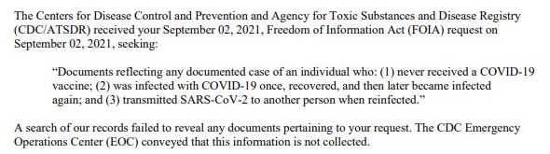
The CDC recently admitted they have is no evidence that unvaccinated people who recovered from COVID had ever transmitted this disease to anyone else.
Downloaded from: https://twitter.com/MichaelPSenger/status/1458953737397948418?ref_src=twsrc%5Etfw%7Ctwcamp%5Etweetembed%7Ctwterm%5E1458953737397948418%7Ctwgr%5E%7Ctwcon%5Es1_&ref_url=https%3A%2F%2Fwww.thegatewaypundit.com%2F2021%2F11%2Fcdc-admits-no-record-unvaccinated-person-spreading-covid-recovering-covid%2F

Slide 12
3. How effective are the vaccines for mitigating transmission of COVID-19?

Slide 13
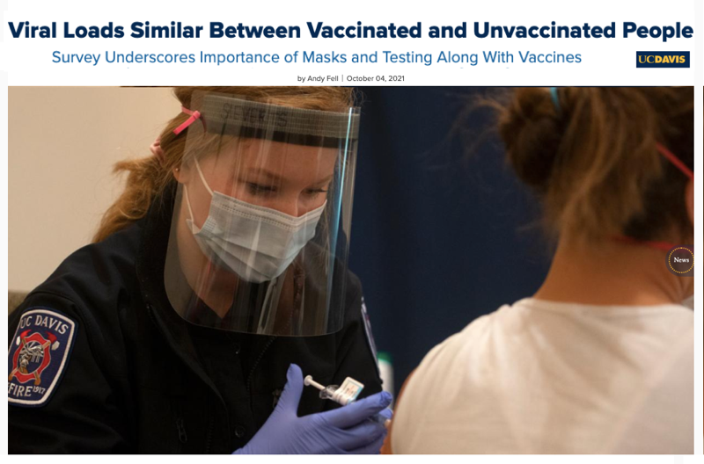
COVID-19 vaccines do not stop viral transmission.
Downloaded from “UC Davis” https://www.ucdavis.edu/health/covid-19/news/viral-loads-similar-between-vaccinated-and-unvaccinated-people

Slide 14
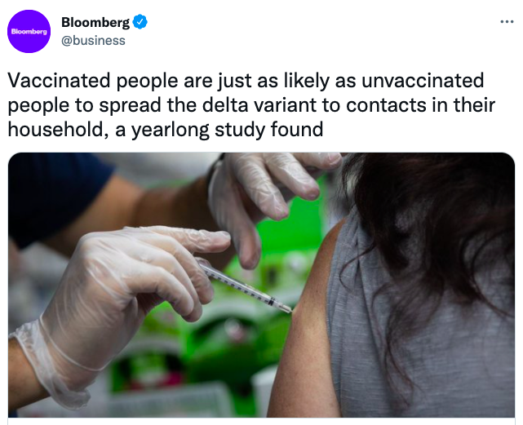
COVID vaccines play no role in mitigating viral transmission.
This can be corroborated by comparing data from other nations.
Downloaded from Bloomberg Business: https://twitter.com/business/status/1453772598504919041?ref_src=twsrc%5Etfw%7Ctwcamp%5Etweetembed%7Ctwterm%5E1453772598504919041%7Ctwgr%5E%7Ctwcon%5Es1_&ref_url=https://www.revolver.news/

Slide 15
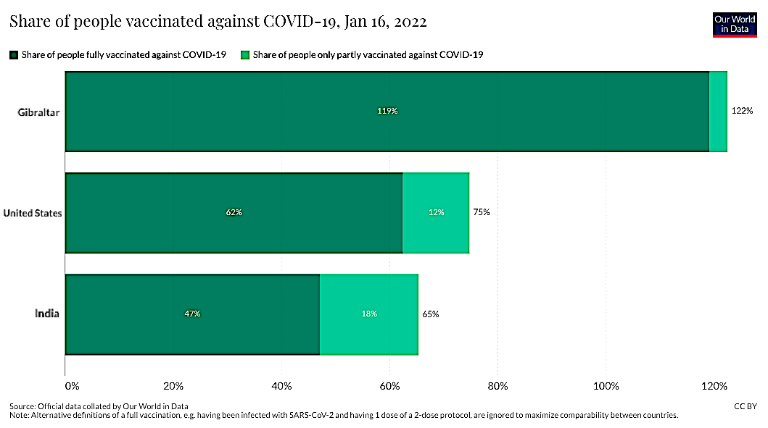
The island of Gibraltar is one of the most vaccinated regions on Earth.
How has 119% vaccination affected the transmission rate of COVID-19?
Downloaded from “Our World in Data” https://ourworldindata.org/covid-vaccinations

Slide 16
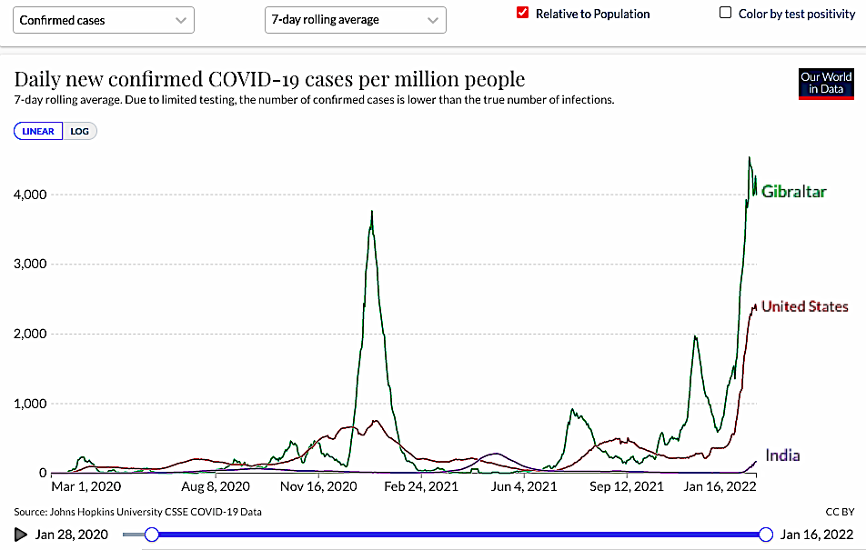
Gibraltar has one of the highest infection rates worldwide.
Downloaded from “Our World in Data” https://ourworldindata.org/covid-cases

Slide 17
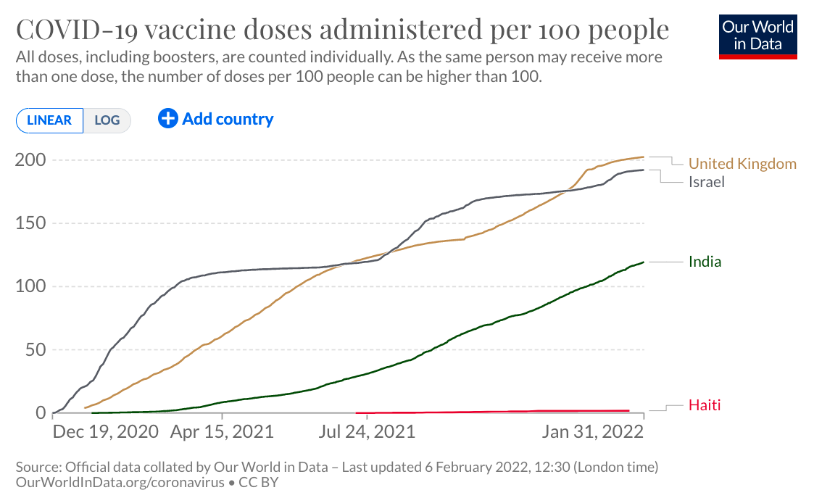
Haiti is the least vaccinated nation in the Western Hemisphere.
How has minimal vaccination affected the death rate for COVID-19?
Downloaded from “Our World in Data” https://ourworldindata.org/covid-vaccinations

Slide 18
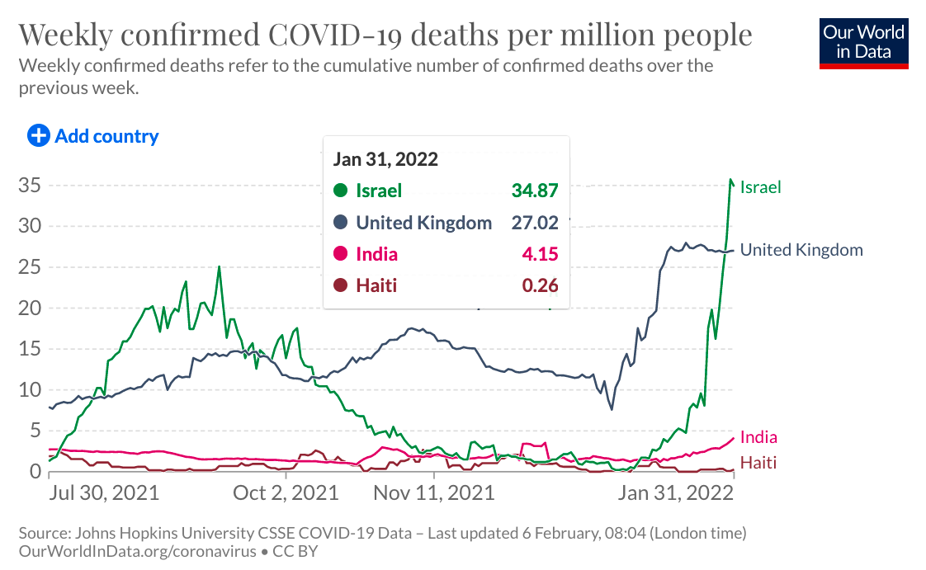
Haiti has one of the lowest death rates from COVID-19.
Downloaded from “Our World in Data” https://ourworldindata.org/covid-deaths

Slide 19
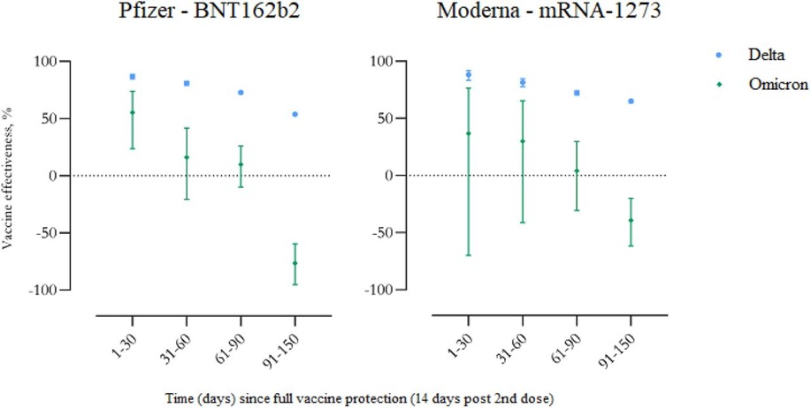
This study shows negative vaccine efficacy for Omicron after 90 days.
This means that vaccination increases the likelihood of getting infected.
Even though this study is just a “preprint” (not yet peer reviewed),
data collected in other nations appears to corroborate these findings.
Hansen et al. 2021 : https://www.medrxiv.org/content/10.1101/2021.12.20.21267966v3.full

Slide 20
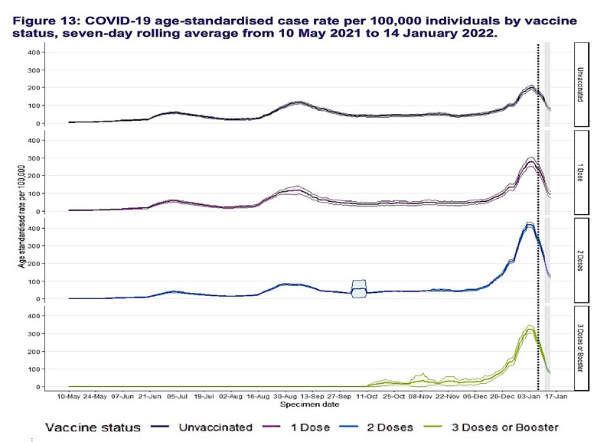
In Scotland, vaccinated people are getting infected at much higher rates.
unvax
vax
vax
vax
Downloaded from p. 40 of the “Public Health Scotland COVID-19 & Winter Statistical Report” https://publichealthscotland.scot/media/11223/22-01-19-covid19-winter_publication_report.pdf

Slide 21
4. What are disadvantages of mass vaccination against COVID-19?

Slide 22
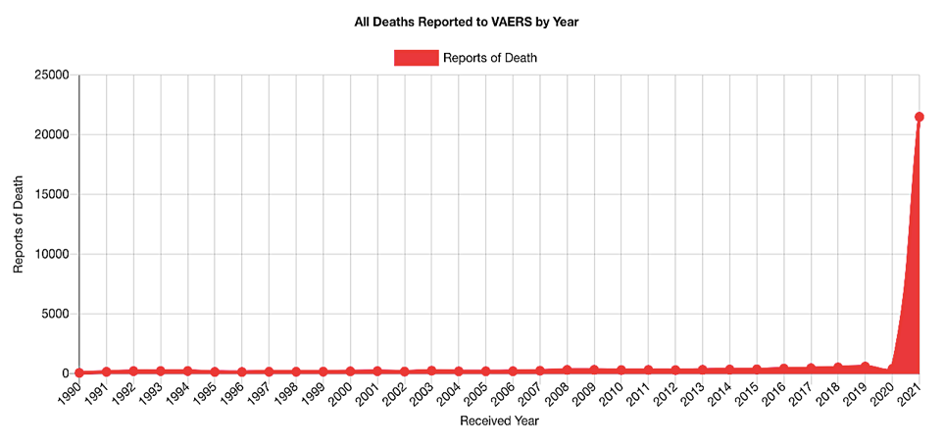
Vaccine-related deaths spiked by 50X in 2021.
Downloaded from “Open VAERS” https://openvaers.com/covid-data

Slide 23
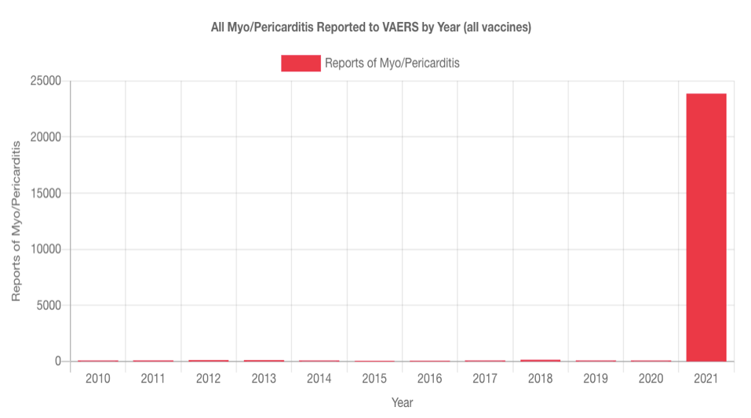
Vaccine-related heart inflammation spiked by nearly 1000X in 2021.
Downloaded from “Open VAERS” https://openvaers.com/covid-data/myo-pericarditis

Slide 24
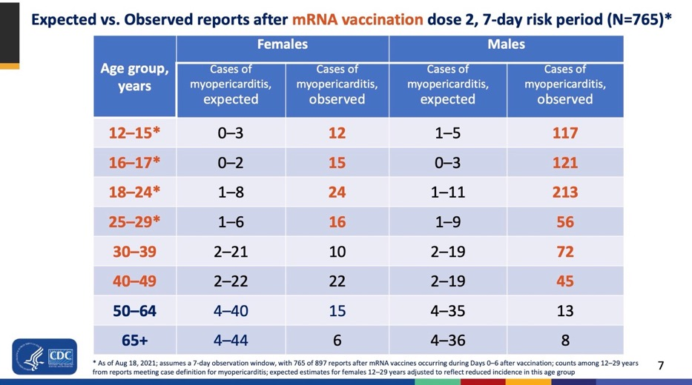
Even the CDC reported a massive increase in vaccine-related myocarditis in young men.
Downloaded from “Myopericarditis following COVID-19 vaccination: Updates from the Vaccine Adverse Event Reporting System (VAERS)” Aug 30, 2021 https://www.cdc.gov/vaccines/acip/meetings/downloads/slides-2021-08-30/03-COVID-Su-508.pdf

Slide 25
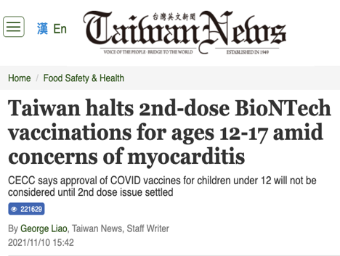
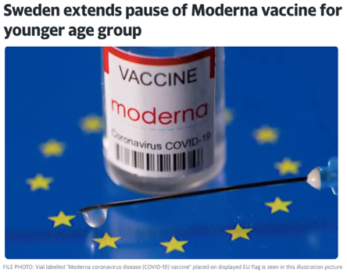
Some nations are now restricting access to the Moderna vaccine based on this data.
Downloaded from: https://www.taiwannews.com.tw/en/news/4340862 &
https://news.yahoo.com/sweden-extends-pause-moderna-covid-121039861.html

Slide 26
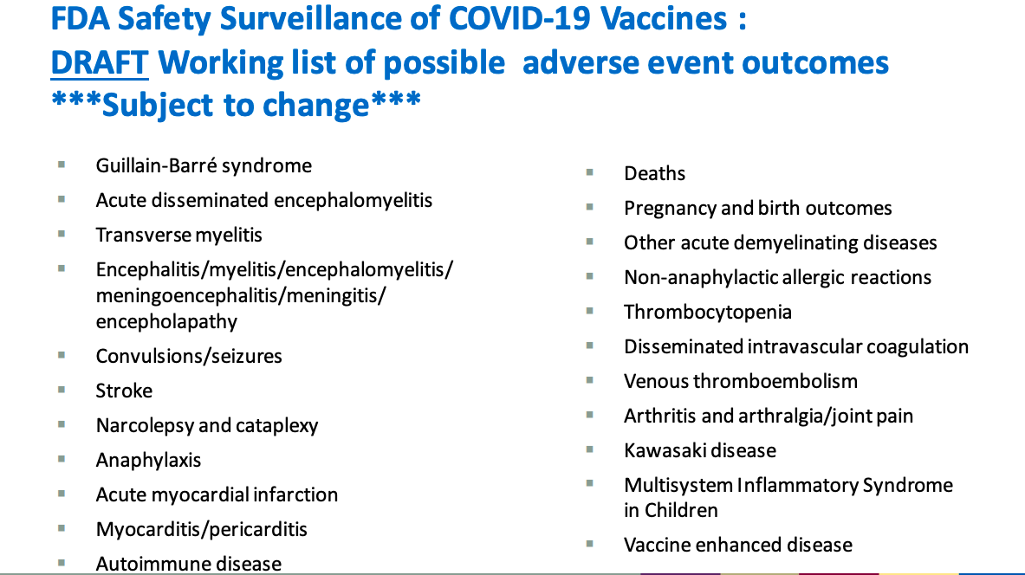
The FDA predicted all these adverse reactions before the COVID vaccines were made available.
Downloaded from the FDA’s “Vaccines and Related Biological Products Advisory Committee October 22, 2020 Meeting Presentation” https://www.fda.gov/media/143557/download

Slide 27
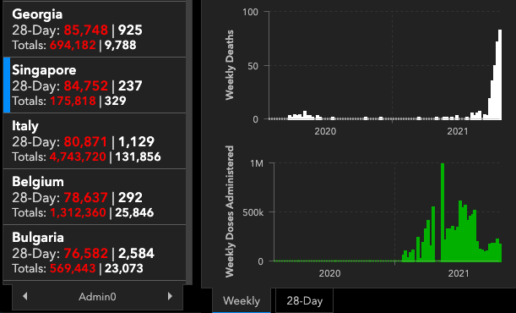
COVID(?) deaths spiked in Singapore following mass vaccination.
Downloaded from John Hopkin’s “Coronavirus Resource Center”: https://coronavirus.jhu.edu/map.html
This is not an anomaly: A similar pattern was recorded in Bahamas, Barbados, Brunei, Cambodia, Dominica, Fiji, Grenada, Laos, Malaysia, Maldives, Seychelles, South Korea, St. Kitts & Nevis, Taiwan, Thailand, Trinidad & Tobago, Sri Lanka, and Uruguay.
Do not take my word for it. Explore the John Hopkins website and look it up.

