Slide 1
5. Why do the CDC and FDA continue to promote these questionable injections?

Slide 2
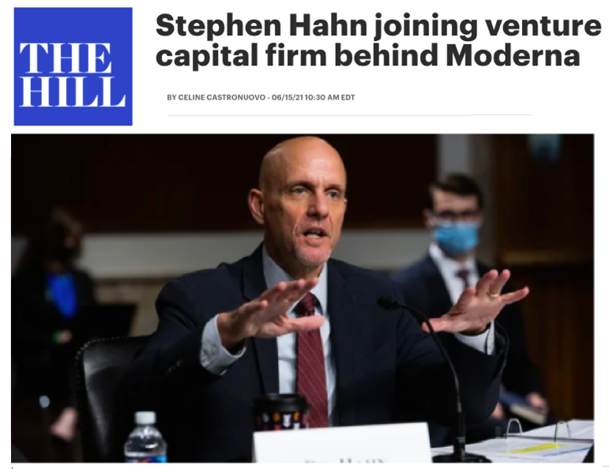
The Revolving Door
Downloaded from “The Hill” https://thehill.com/policy/healthcare/558469-stephen-hahn-joining-venture-capital-firm-behind-moderna

Slide 3
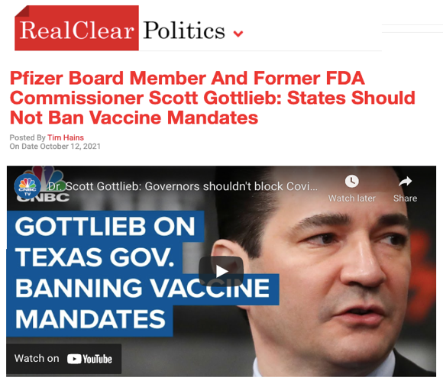
The Revolving Door
Downloaded from “Real Clear Politics” https://www.realclearpolitics.com/video/2021/10/12/pfizer_board_member_former_fda_commissioner_and_cnbc_contributor_scott_gottlieb_governors_should_not_ban_corporate_vaccine_mandates.html

Slide 4
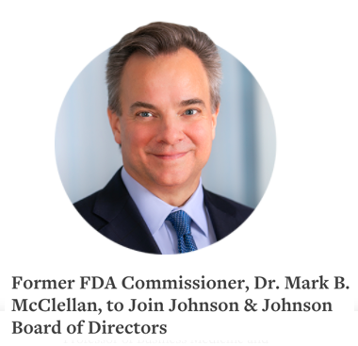
The Revolving Door
Downloaded from “Johnson & Johnson website” https://www.jnj.com/media-center/press-releases/former-fda-commissioner-dr-mark-b-mcclellan-to-join-johnson-johnson-board-of-directors

Slide 5
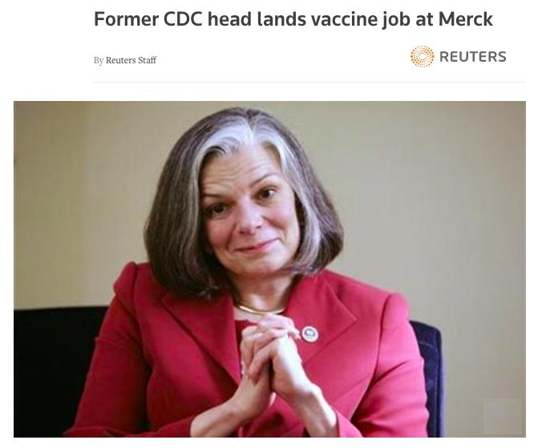
The Revolving Door
Downloaded from “Reuters” https://www.reuters.com/article/us-merck-gerberding-idUSTRE5BK2K520091221

Slide 6
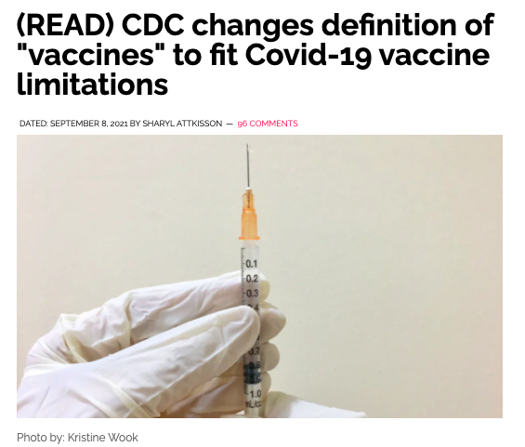
These are your tax dollars at work:
Downloaded from “SHARYL ATTKISSON” https://sharylattkisson.com/2021/09/read-cdc-changes-definition-of-vaccines-to-fit-covid-19-vaccine-limitations/

Slide 7
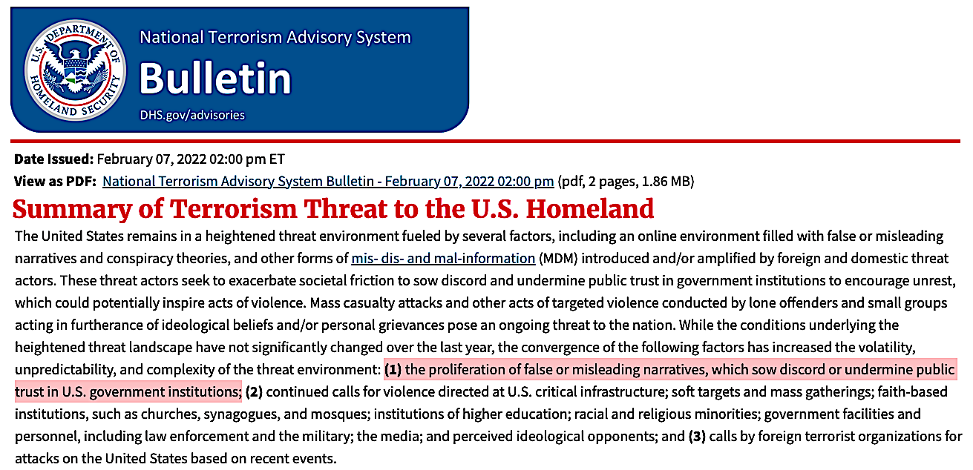
The US Department of Homeland Security now regards narratives that undermine “trust in government institutions” as a “terrorist threat.”
But if they are so concerned about “false or misleading narratives”…
https://www.dhs.gov/ntas/advisory/national-terrorism-advisory-system-bulletin-february-07-2022

Slide 8
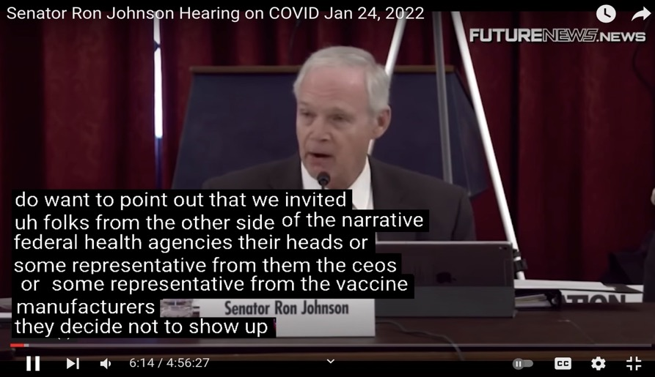
…why did federal health agencies decline Ron Johnson’s invitation to attend a hearing on vaccine injuries and alternative treatments for COVID-19?
Why decline such a golden opportunity to counter the “misinformation”?
https://www.youtube.com/watch?v=QxkqEE-Qnw0

Slide 9
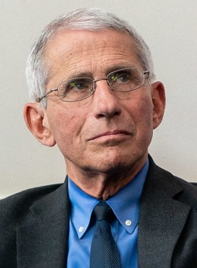
…it’s easy to criticize [me], but they’re really criticizing science because I represent science
Anthony Fauci
https://www.msn.com/en-us/news/technology/i-represent-science-is-the-talk-of-tyrants/ar-AARjmEp

Slide 10
6. Why was there no outpatient treatment for COVID-19?

Slide 11
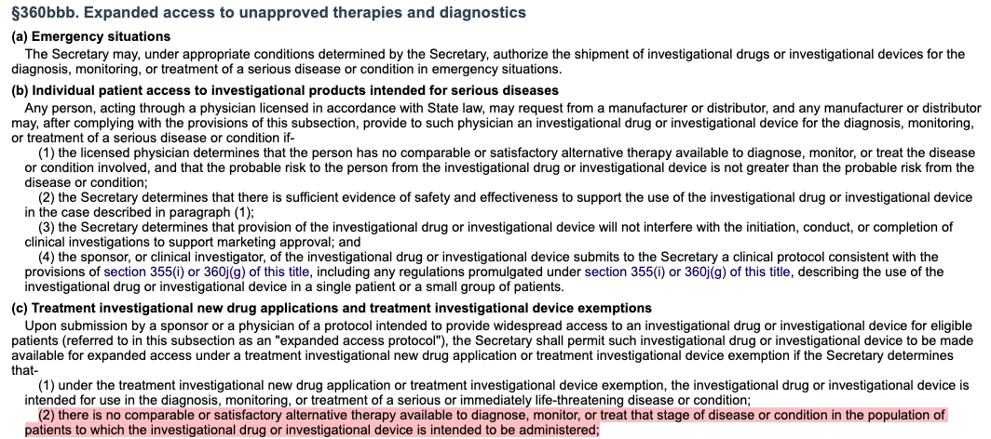
According to U.S. Code 360bbb, "expanded access to unapproved therapies" requires absence of any other "comparable or satisfactory alternative therapy."
Downloaded from: https://uscode.house.gov/view.xhtml?req=(title:21%20section:360bbb%20edition:prelim)

Slide 12
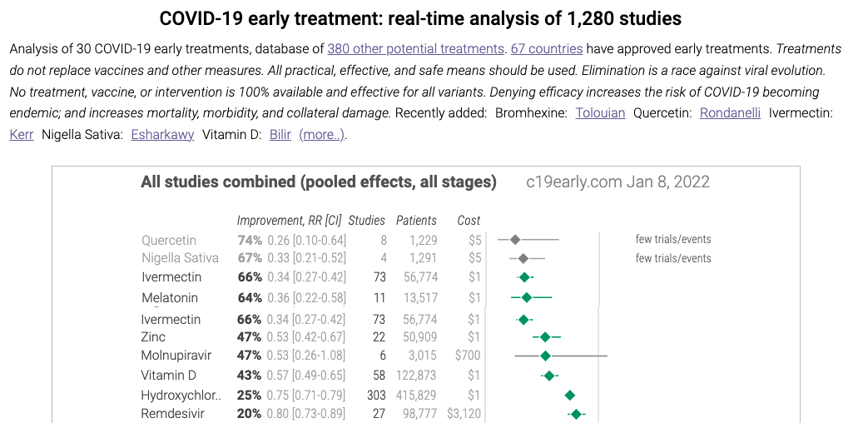
Generic outpatient therapies were suppressed so COVID vaccines could meet the conditions required for “emergency use authorization.”
Their effectiveness can be corroborated by comparing data from other nations.
Downloaded from: https://c19early.com/

Slide 13
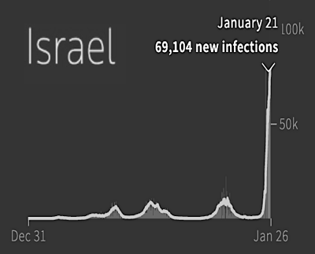
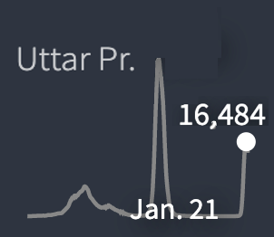
On 1/21/22, the average infection rate for new cases of COVID for the Indian province of Uttar Pradesh was 68 per million.
On 1/21/22, the average infection rate for new cases of COVID-19 for the (70% vaccinated) nation of Israel was 7,800 per million.
Total population: 8.9 million
Total population: 241 million
What measures were taken in Uttar Pradesh?
Downloaded from Reuter’s COVID-19 Global tracker: https://graphics.reuters.com/world-coronavirus-tracker-and-maps/

Slide 14
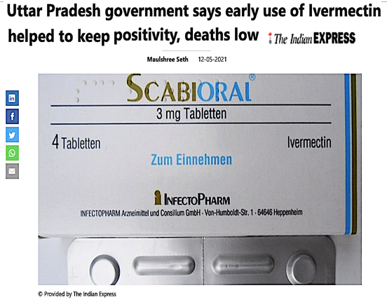
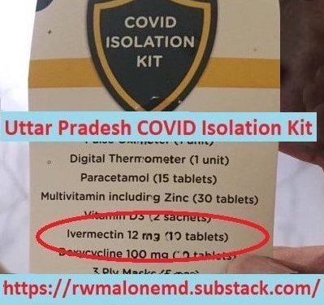
Outpatient therapeutics were widely distributed throughout the province of Uttar Pradesh due to lack of access to vaccines.
The image on the right was taken by a visitor after “fact-checkers” tried to downplay the role of Ivermectin in Uttar Pradesh.
Downloaded from: https://www.msn.com/en-in/news/other/uttar-pradesh-government-says-early-use-of-ivermectin-helped-to-keep-positivity-deaths-low/ar-BB1gDp5U

Slide 15
For NPR, Haiti’s low death rate from COVID is a “mystery.”
https://www.npr.org/sections/goatsandsoda/2021/05/04/992544022/one-of-the-worlds-poorest-countries-has-one-of-the-worlds-lowest-covid-death-rat
But alternative media sources attribute this to widespread use of Ivermectin as prophylaxis against parasites.
https://dr1.com/wordpress/2021/01/12/haiti-10000-covid-19-cases-the-dr-183000-could-mass-parasite-campaigns-with-ivermectin-have-made-the-difference/

Slide 16
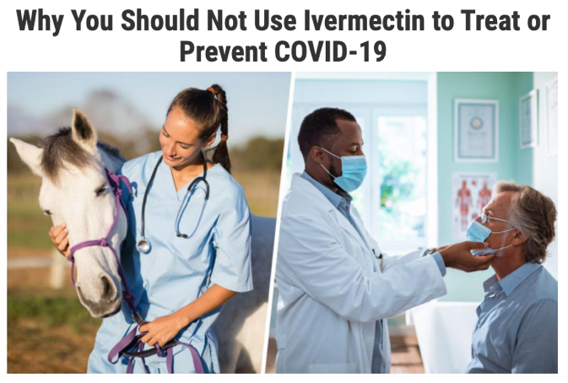
Nearly all health care systems in the US do not allow use of Ivermectin for COVID-19 due to FDA guidelines.
Downloaded from the FDA: https://www.fda.gov/consumers/consumer-updates/why-you-should-not-use-ivermectin-treat-or-prevent-covid-19

Slide 17
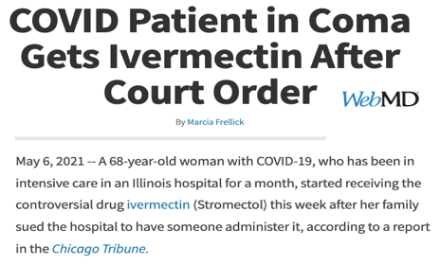
Hospitals are so resistant to using Ivermectin for COVID-19 that dying patients often have to resort to a court order.
Downloaded from: https://www.nola.com/news/coronavirus/article_cdf07cf2-22e4-11ec-9085-870c1ea5bde0.html
Downloaded from: https://www.webmd.com/lung/news/20210506/covid-patient-in-coma-gets-ivermectin-after-court-order

Slide 18
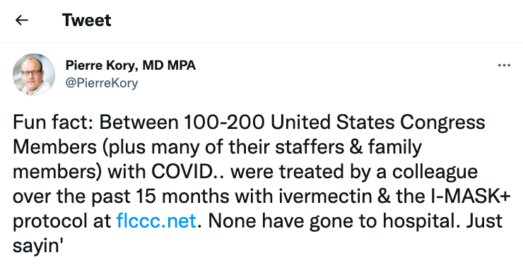
This is less of a problem for members of congress.
Downloaded from: https://twitter.com/PierreKory/status/1446312291302055940

Slide 19
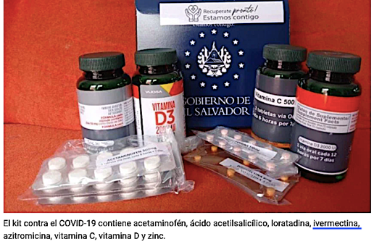
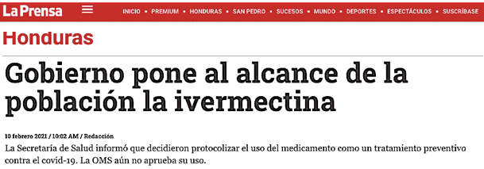
Shockingly, even the banana republics of Honduras and El Salvador are doing a far better job of protecting their citizens from COVID-19.
https://saludconlupa.com/noticias/el-salvador-guatemala-y-bolivia-ofrecen-kits-de-medicinas-para-covid-19-sin-prever-reacciones-adversas/
https://www.laprensa.hn/honduras/honduras-gobierno-pone-alcance-poblacion-ivermectina-BWLP1441770

Slide 20
8. Was SARS-CoV-2 made in a lab?

Slide 21
According to the US National Institute of Health, SARS-CoV-2 “is likely the result of viral evolution in nature.”
Downloaded from https://www.nih.gov/about-nih/who-we-are/nih-director/statements/statement-misinformation-about-sars-cov-2-origins

Slide 22
The FCS plays a key role facilitating entry of the virus into human cells.
But doubts about natural origin were raised shortly after the virus was isolated due to the unique presence of the “furin cleavage site.”
https://twitter.com/livemint/status/1305394599460913153?ref_src=twsrc%5Etfw%7Ctwcamp%5Etweetembed%7Ctwterm%5E1305394599460913153%7Ctwgr%5E%7Ctwcon%5Es1_&ref_url=https%3A%2F%2Fen.as.com%2Fen%2F2020%2F09%2F15%2Flatest_news%2F1600196698_232755.html
Downloaded from randombio.com: https://www.randombio.com/covid-furin-site.html
The FCS consists of four amino acids that occur on the “spike” protein.
The FCS is not found any of the other coronaviruses isolated from bats.

Slide 23
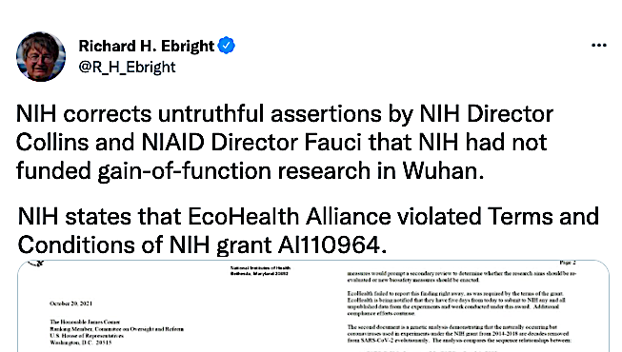
Perhaps they do not want to come clean about research that involved the engineering of bat virus genes at the WIV.
Why does the NIH continue to double down this narrative?
This is not a “smoking gun,” but it raises important questions:
Why is NIH throwing EcoHealth Alliance under the bus?
Why did Directors Collins and Fauci lie when asked about this?
Downloaded from: https://twitter.com/R_H_Ebright/status/1450947395508858880

Slide 24
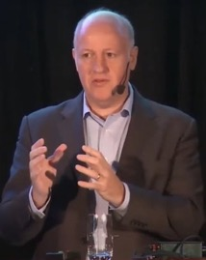
Statement made at Forum on Medical and Public Health Preparedness for Catastrophic Events, February 12, 2016
https://www.ncbi.nlm.nih.gov/books/NBK349040/
We need to increase public understanding of the need for medical counter-measures such as a pan-coronavirus vaccine.
A key driver is the media, and the economics will follow the hype.
Peter Daszak, president of EcoHealth Alliance

Slide 25
We don't really know what that magical point of herd immunity is, but we do know that if we get the overwhelming population vaccinated, we're going to be in good shape. We ultimately would like to get and have to get children into that mix.
Anthony Fauci
https://www.wfsb.com/news/us-likely-needs-to-include-vaccinating-children-to-reach-herd-immunity-fauci-says/article_1447bf14-c9b0-5487-a34a-d33f90a9fb90.html

Slide 26
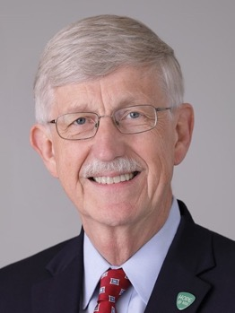
Parents of unvaccinated kids should be thoughtful about [pediatric patients] …And the recommendation is to wear masks [at home] as well. I know it’s uncomfortable. I know it seems weird. But it is the best way to protect your kids.
Francis Collins
https://www.msn.com/en-us/news/us/parents-should-wear-masks-at-home-around-unvaccinated-kids-says-nih-director/ar-AAMTO0q

Slide 27
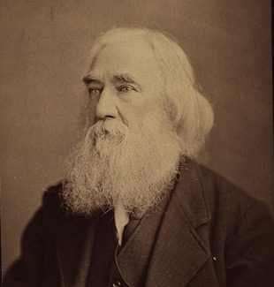
Those who are capable of tyranny are capable of perjury to sustain it.
Lysander Spooner

