Slide 1
A dummy’s guide to using the NIH database to evaluate homology between HIV and SARS-CoV-2

Slide 2
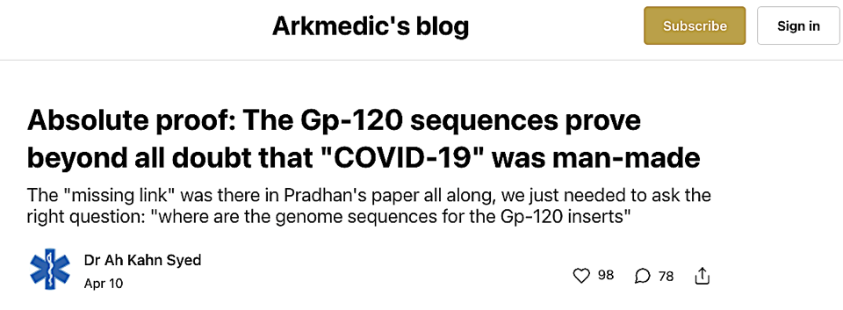
This power point is based in part on instructions provided in this substack article by Dr. Syed
https://arkmedic.substack.com/p/absolute-proof-the-gp-120-sequences?utm_source=%2Fprofile%2F41910983-dr-ah-kahn-syed&utm_medium=reader2&s=r

Slide 3
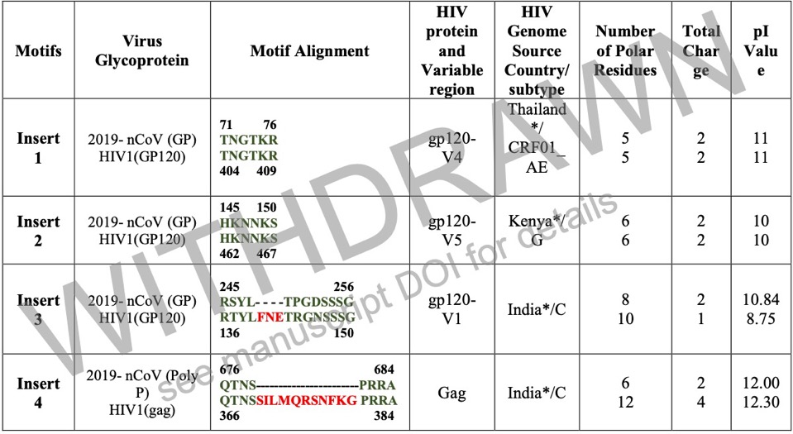
You will be evaluating the following sequences from a preprint previously posted on BioRxiv

Slide 4
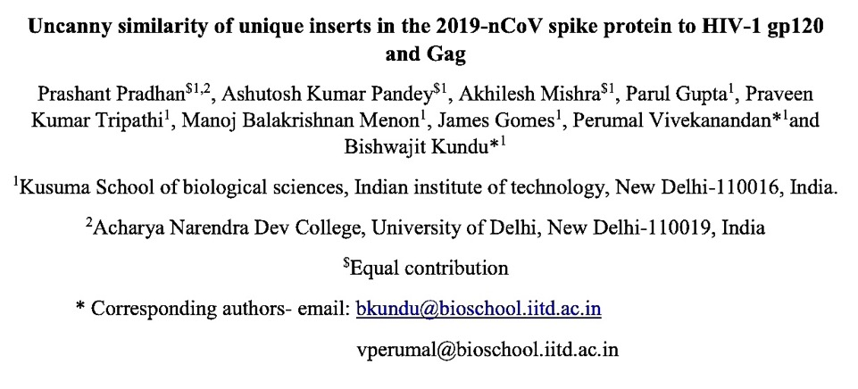
The preprint was mysteriously removed from BioRxiv only three days after it was posted on January 2020.
This power point was prepared so non-biologists can decide
for themselves whether or not this removal was justified.

Slide 5
Click on the following link to open the NIH database
https://blast.ncbi.nlm.nih.gov/Blast.cgi?PROGRAM=blastn&PAGE_TYPE=BlastSearch&LINK_LOC=blasthome

Slide 6
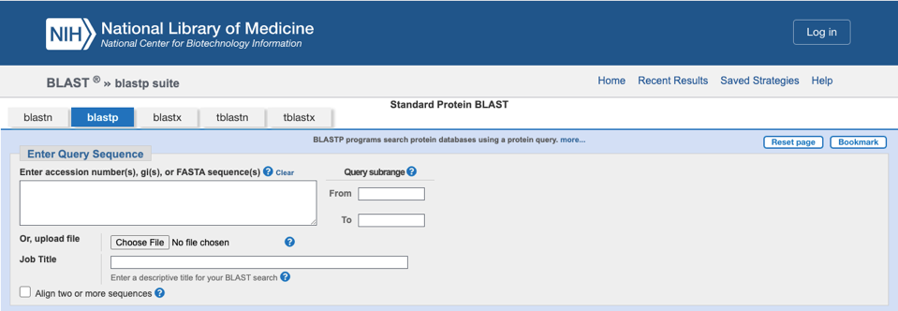
The top of your page will appear like this
Make sure this tab is highlighted in order to
focus your search on amino acid sequences

Slide 7
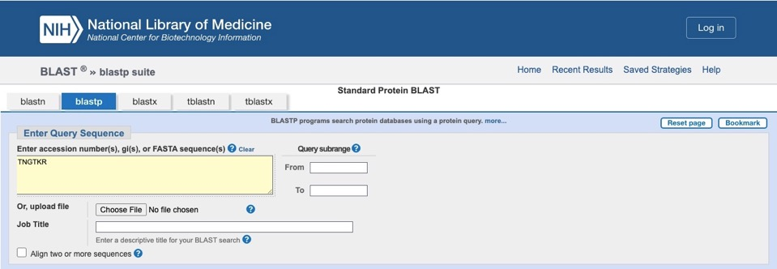
Place cursor in the “Enter Query Sequence” box and enter the first sequence: TNGTKR

Slide 8
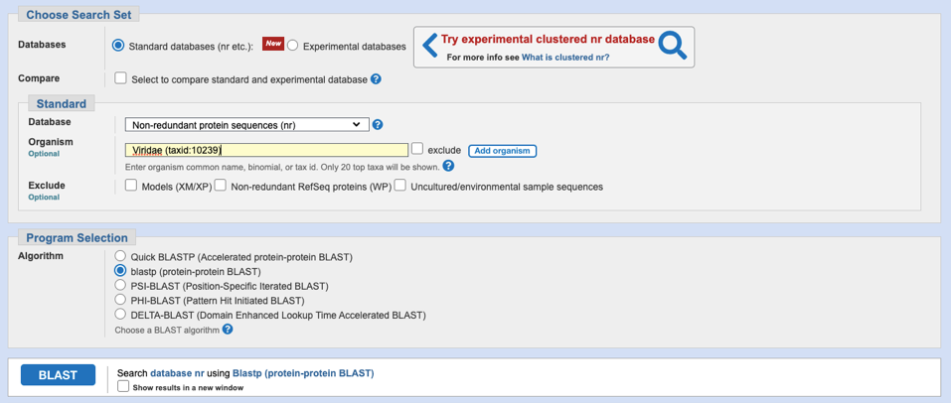
Enter the term “viridae” into this box
Scroll down to near the bottom
Click on “BLAST”

Slide 9
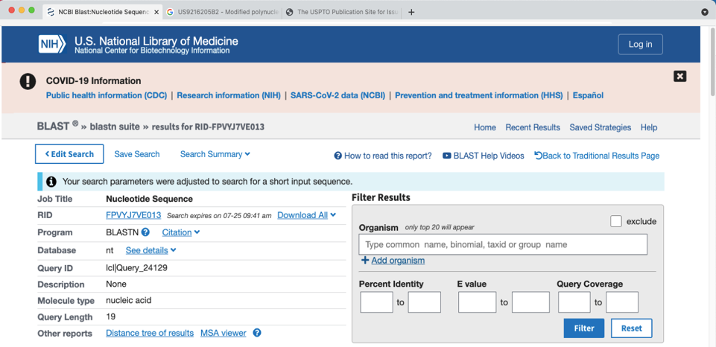
The top of your new page will appear like this
Your query may take a few minutes

Slide 10
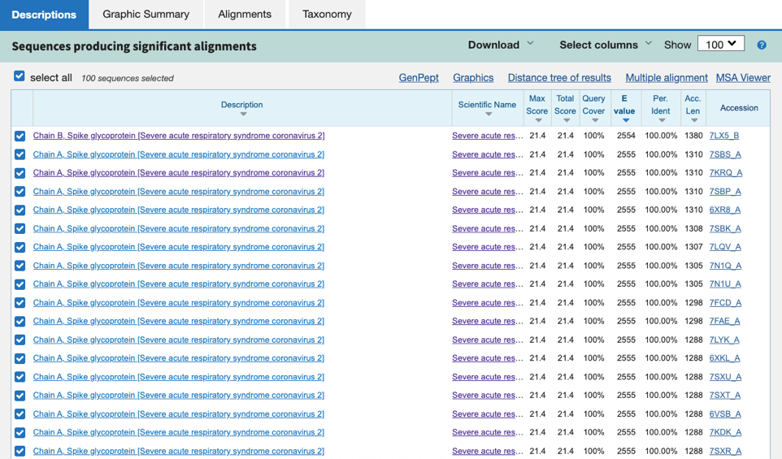
Scroll down to see matches to your query
All these matches correspond to SARS-CoV-2

Slide 11
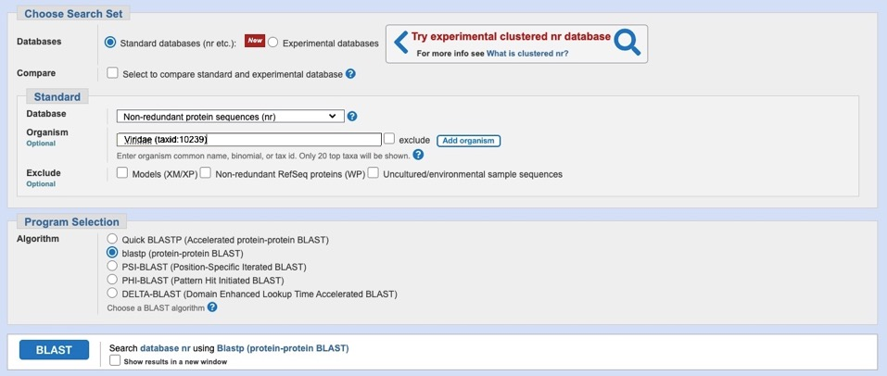
Go back to the initial page for searching
Click on the box that says “add organism”

Slide 12
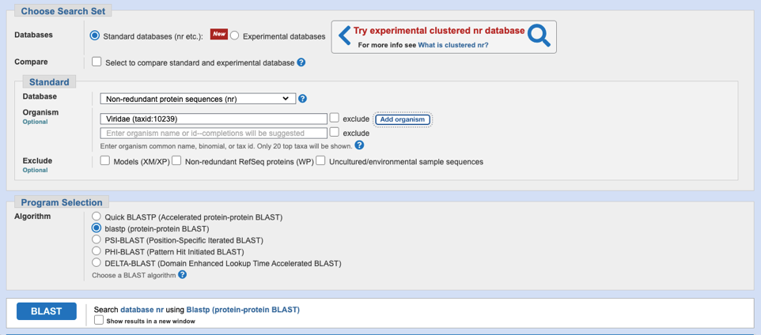
This will result in the addition of a second box

Slide 13
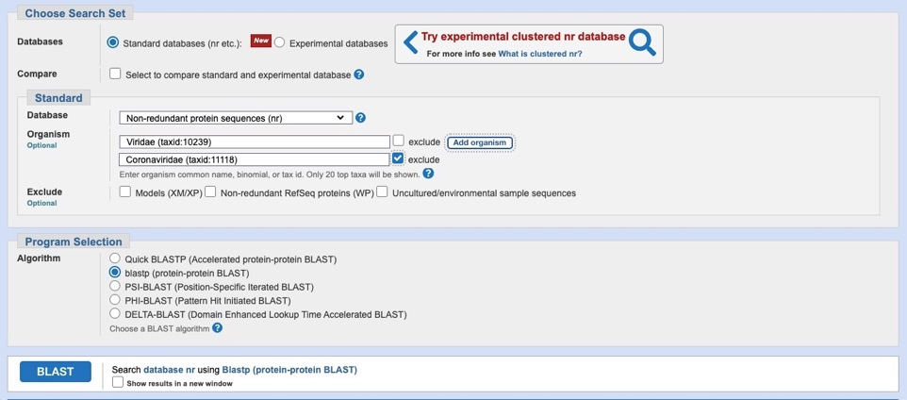
Enter the term “coronaviridae”
Check the “exclude” box on the right
Click on “BLAST”

Slide 14
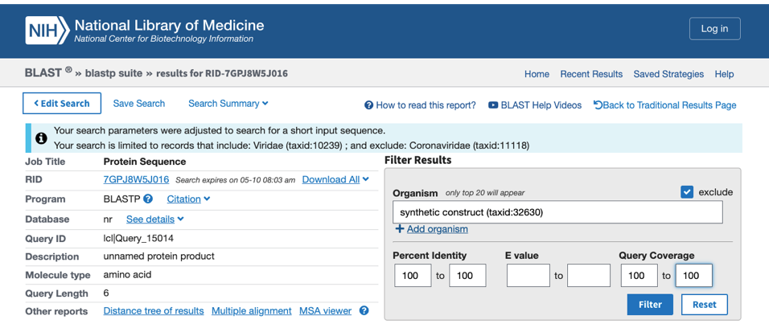
On the next page enter “synthetic” in this box
Check on the “exclude” box
Enter “100” here to exclude imperfect matches
Click on “Filter”

Slide 15
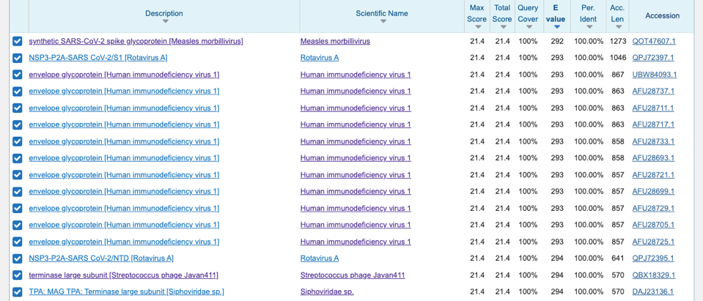
These sequences match the 2nd query
Most matches will correspond to HIV
Some synthetic sequences will get past the filter

Slide 16
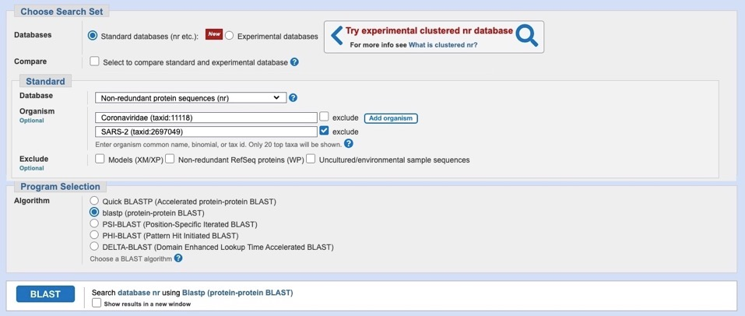
Go back to the starting link for searching and enter these terms in your boxes
This narrows the search to coronaviruses
that exclude sequences for SARS-CoV-2
Click on “BLAST”

Slide 17
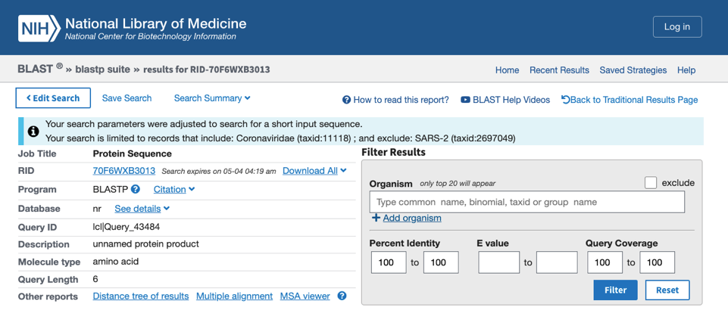
On the next page enter “100” in these boxes
Click on “Filter”

Slide 18
Scroll down and you will find the few sequences that match the criteria for your 3rd query
Click on the “Accession” link to get the date
All these accession dates are 2021 or later

Slide 19
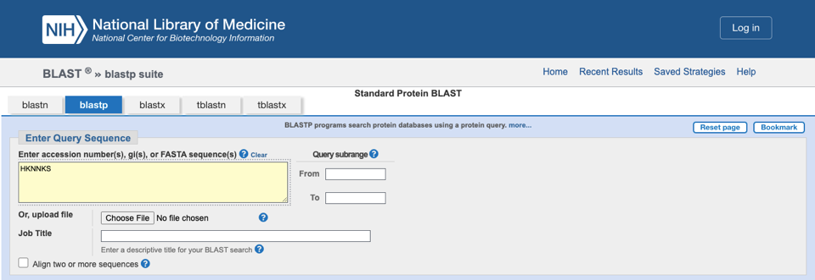
Repeat the entire query procedure for the second sequence: HKNNKS

Slide 20
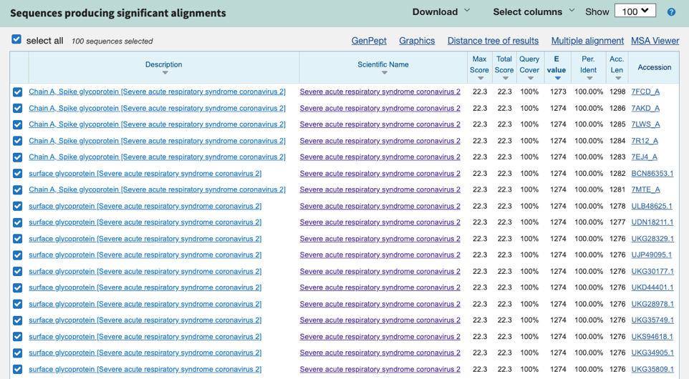
This is the result for your 1st query for HKNNKS
All these matches correspond to SARS-CoV-2

Slide 21
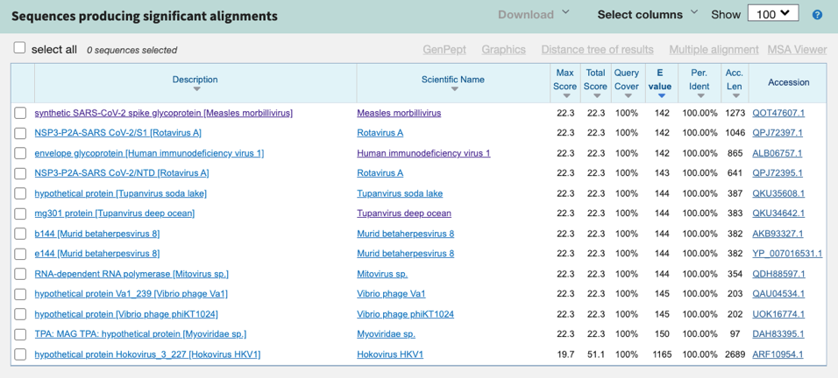
This is the result for your 2nd query for HKNNKS
Note how the HIV sequence matches perfectly

Slide 22
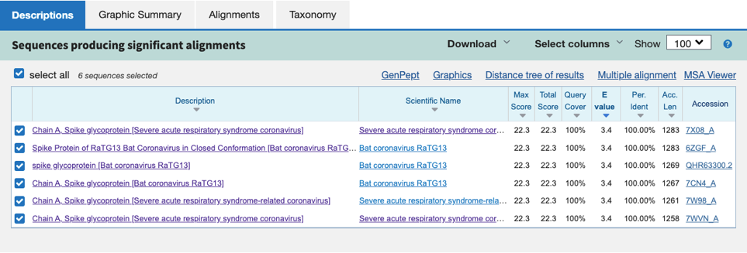
This is the result for your 3rd query for HKNNKS
All these accession dates are 2021 or later

Slide 23
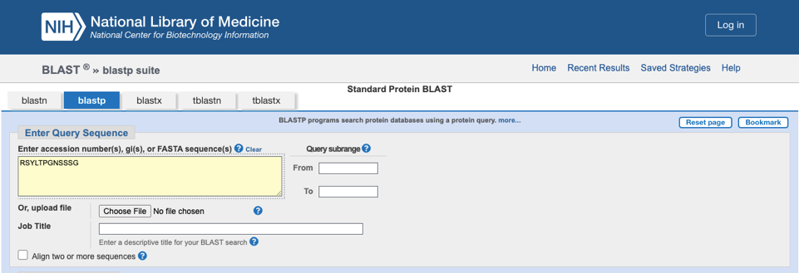
Repeat the entire query procedure for the 3rd sequence: RSYLTPGNSSSG

Slide 24
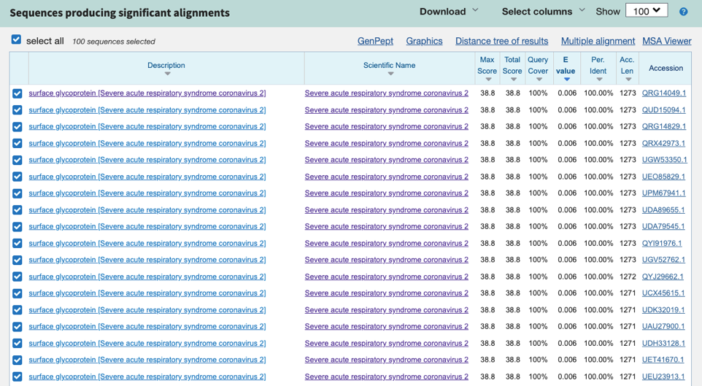
This is the result of your 1st query for RSY…SSG
All these matches correspond to SARS-CoV-2

Slide 25
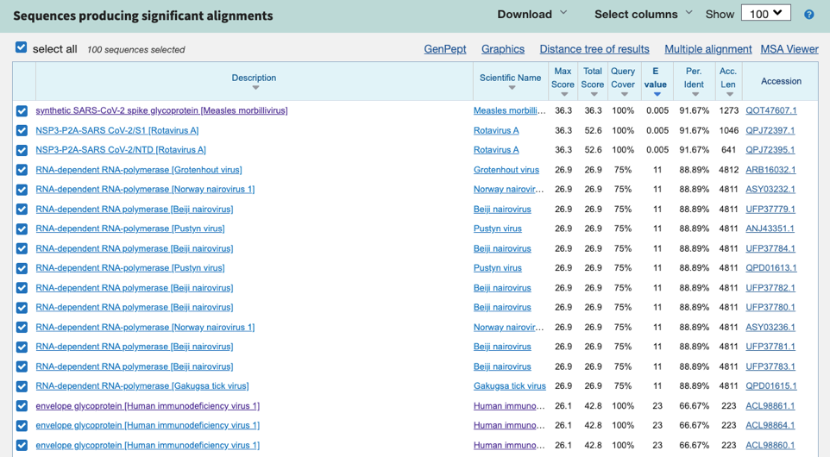
For your 2nd query for RSY…SSG do not use the 100% filter
This is the result of your 2nd query for RSY…SSG
The distance tree maximum score for HIV is 26.1

Slide 26
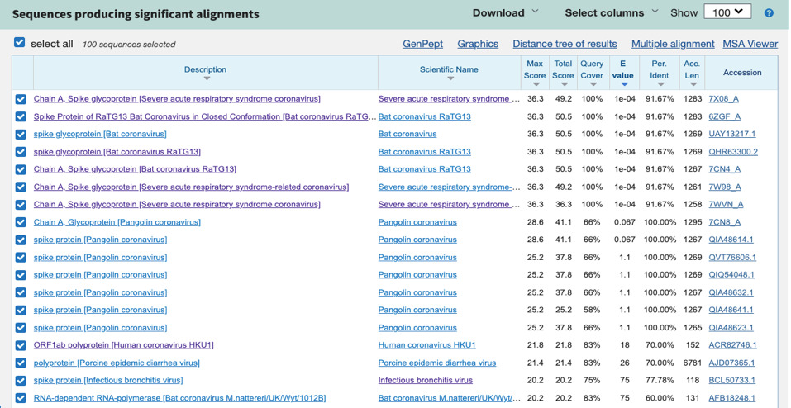
For your 3rd query for RSY…SSG do not use the 100% filter
This is the result of your 2nd query for RSY…SSG
All matches entered prior to 2020 score 21.8 or lower
This is significantly lower than the score of 26.1 for HIV

Slide 27
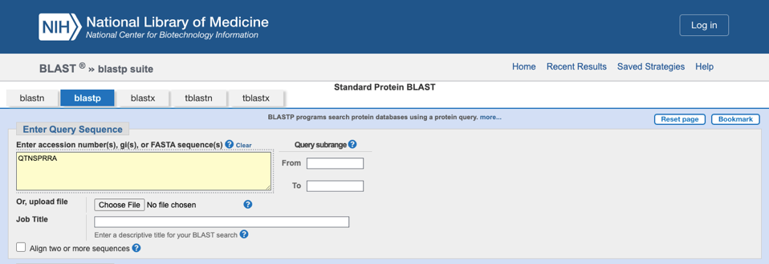
Repeat the entire query procedure for the 4th sequence: QTNSPRRA

Slide 28
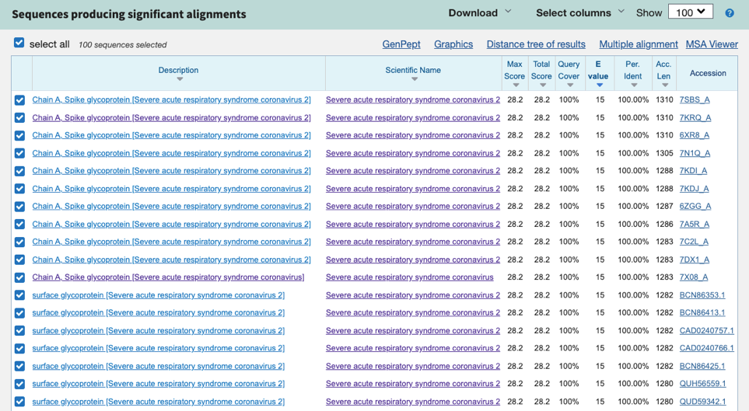
This is the result of your 1st query for QTNSPRRA
All these matches correspond to SARS-CoV-2

Slide 29
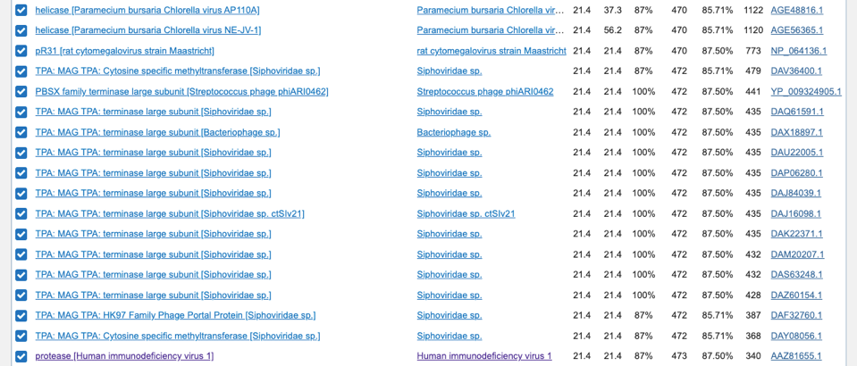
For the 2nd query for QTNSPRRA do not use the 100% filter
The distance tree maximum score for HIV is 21.4

Slide 30
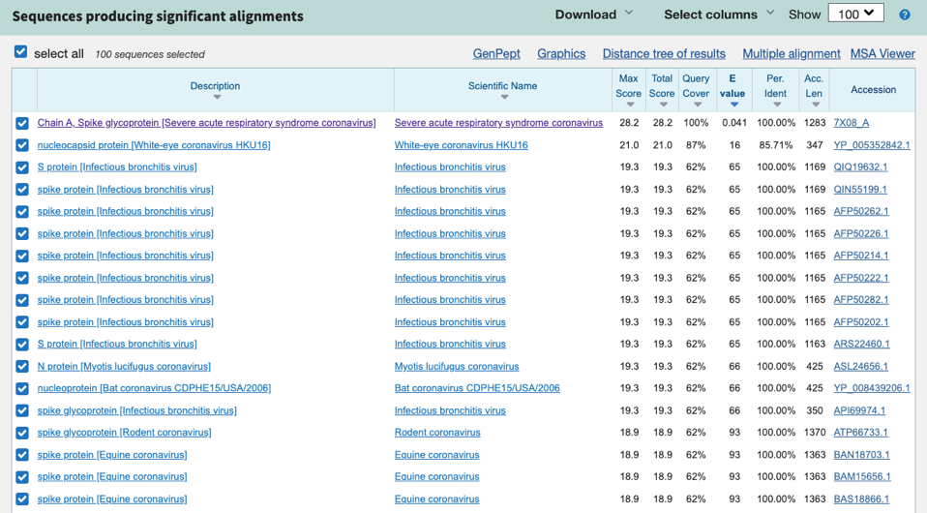
For your 3rd query for QTNSPRRA do not use the 100% filter
All matches entered before 2020 score 19.3 or lower

Slide 31
What does this mean?
1) The 1st and 2nd sequences from SARS-CoV-2 line up perfectly with amino acid sequences on HIV.
2) No other virus entered into the NIH database before 2021 forms a perfect match with both the 1st and 2nd sequences.
3) The 3rd and 4th sequences from SARS-CoV-2 show more homology to HIV than for any virus entered prior to 2020.
4) The dates on these viruses are important because some viruses “found” after 2019 may have been fabricated to support the narrative that SARS-CoV-2 came from nature.
5) Based on computer modelling all of these inserts occur on important locations of the spike protein.
6) The 4th sequence is particularly important because it contains the furin cleavage site. The FCS plays a key role facilitating infection.

Slide 32
Statement made at Forum on Medical and Public Health Preparedness for Catastrophic Events, February 12, 2016
https://www.ncbi.nlm.nih.gov/books/NBK349040/
We need to increase public understanding of the need for medical counter-measures such as a pan-coronavirus vaccine.
A key driver is the media, and the economics will follow the hype.
Peter Daszak, president of EcoHealth Alliance

Slide 33
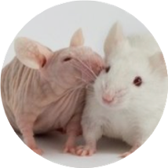
ACKNOWLEDGMENTS:
Thanks to jikkyleaks (fan account) for tips on how to narrow down my search.
https://twitter.com/Jikkyleaks

Slide 34
The original power point (with animations)
can be downloaded from following website:
https://www.firsthandsources.com/

